Slide 1
Global Terrorism Database
Konrad Siebor, Zach Boner, Drew Goldman

Slide 2
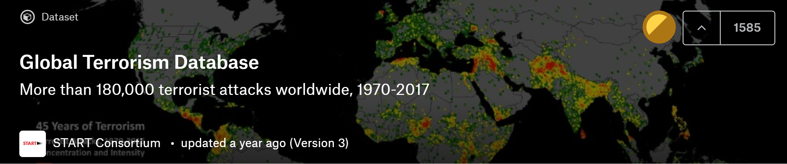
Overview
Available on Kaggle
181691 attacks from 1970-2017 with 135 features
Key features: Location, type of attack, target, civilians killed, etc

Slide 3
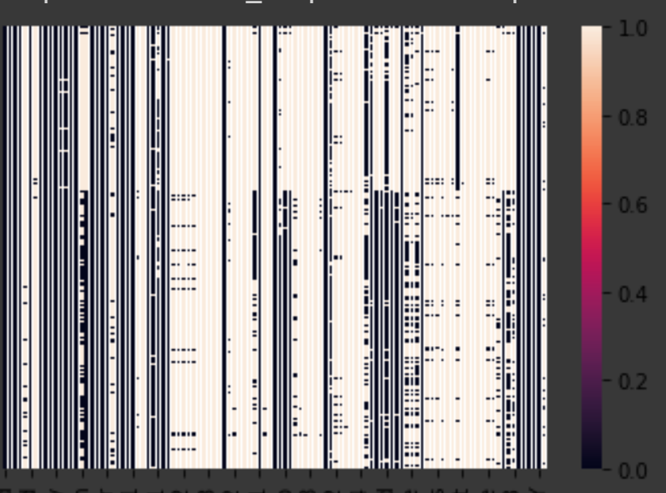
Null Values by Column

Slide 4
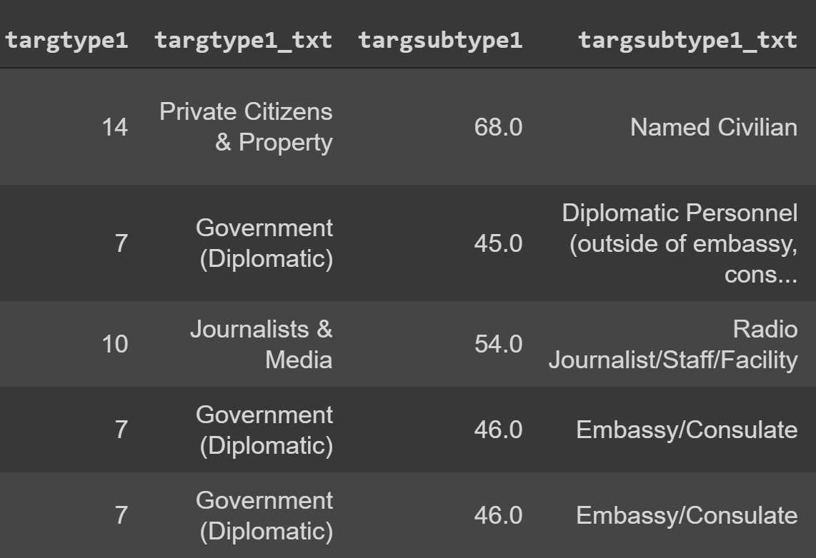
Data Clean-up
One-hot encoded version of categorical columns

Slide 5
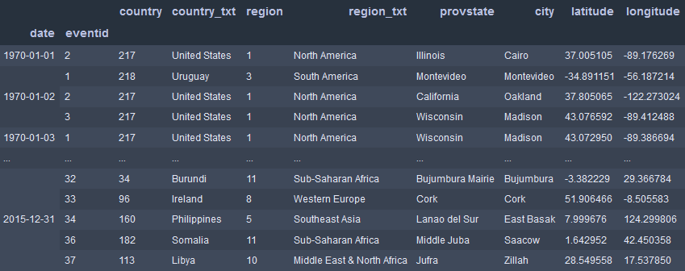
Multi-indexing on date and eventid
Index first on date of event
Index second on the event number of that day

Slide 6
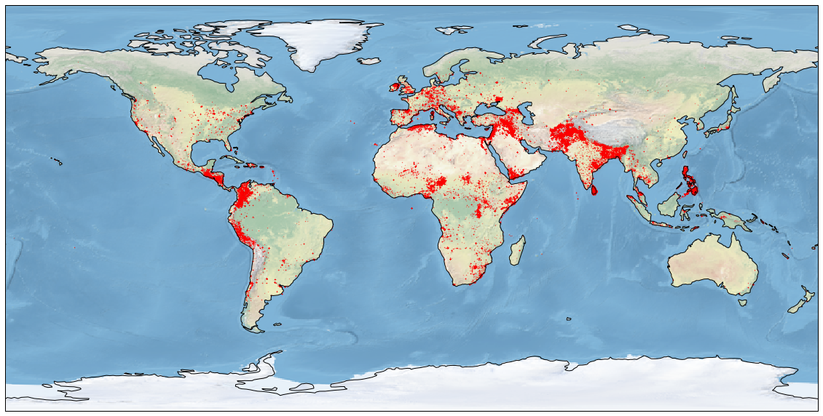
World Map

Slide 7
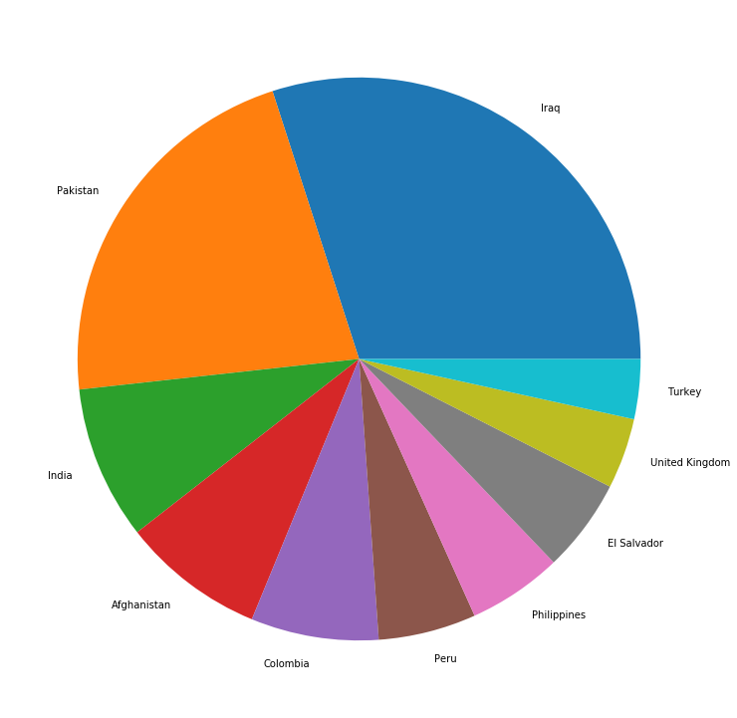
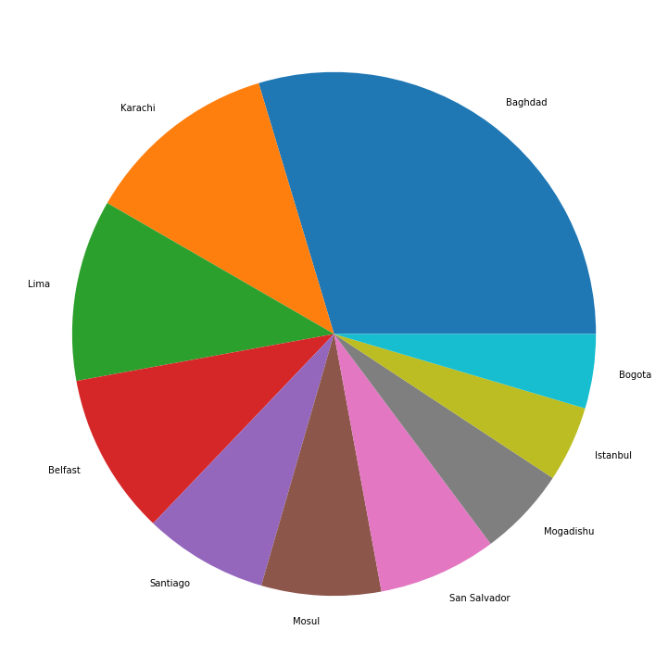
Locations of attacks

Slide 8
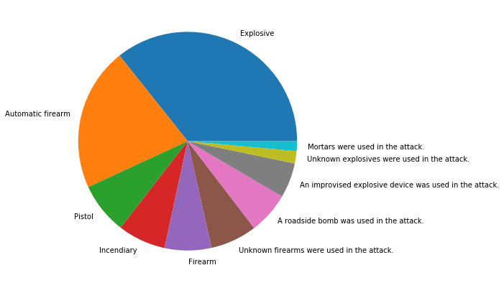
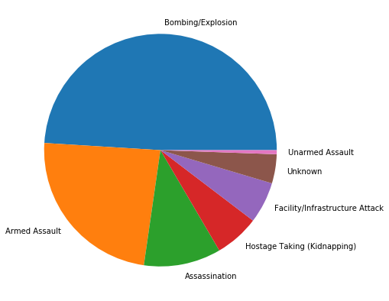
Type of attacks

Slide 9
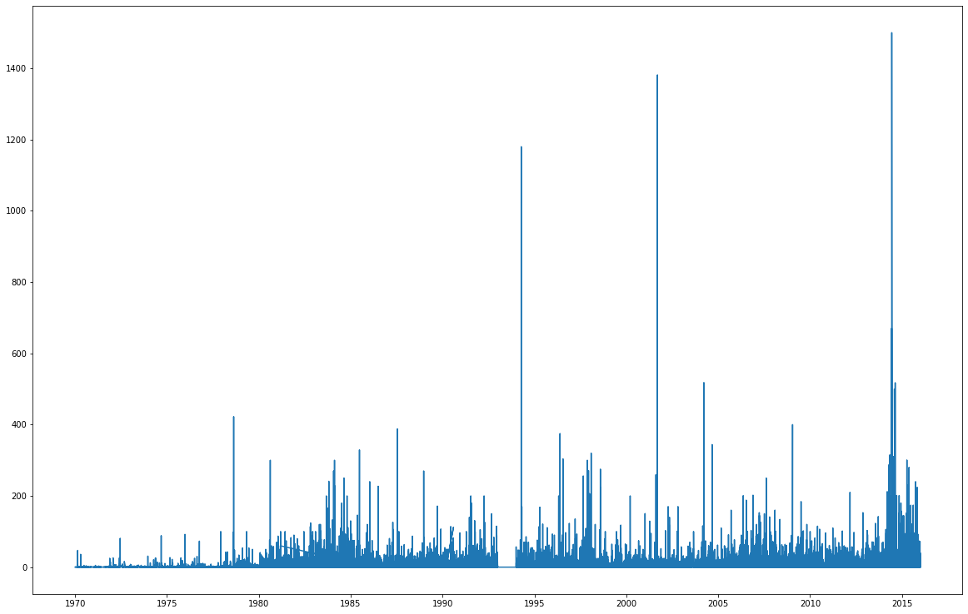
Fatalities over time
Syrian
Civil War
Bosnia
Congo
Rwanda
9/11 and Afghanistan War
War in Afghanistan
Iraq War and Kivu Conflict

Slide 10
Predicting Modeling
Use the features of the data set to predict the number of individuals killed in an attack
Modeling technique needs to output continuous values

Slide 11
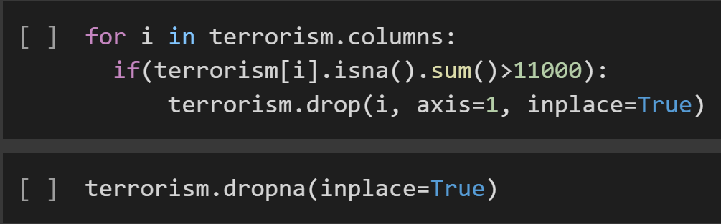
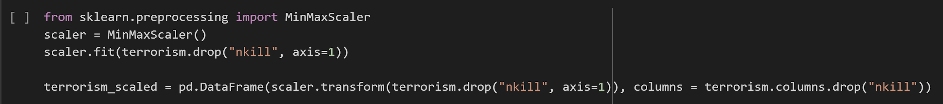
Data Cleaning
Dropping Columns
Dropping Rows
Scaling features

Slide 12
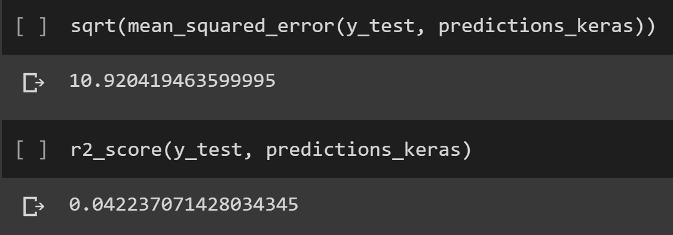
Modeling Techniques
Keras Sequential Model
(Two 64-node dense layers)
Multivariate Linear Regression

Slide 13
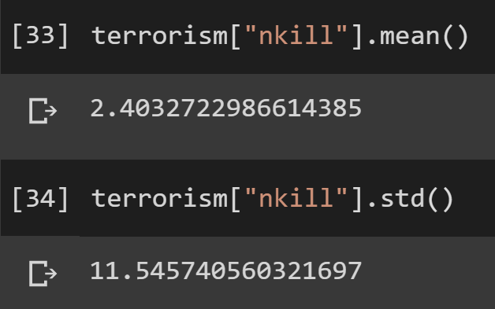
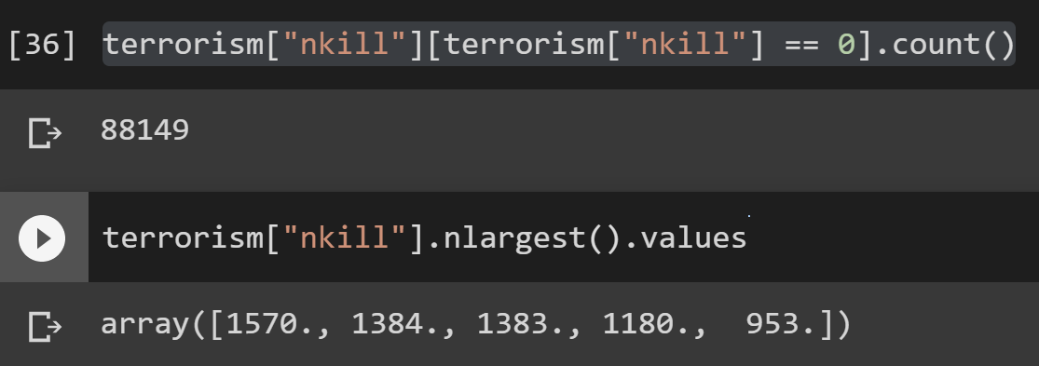
Failure of Prediction
Lack of true quantitative features
Significant loss of feature information due to null values
High variance in the data

Slide 14
References
https://www.start.umd.edu/gtd/downloads/Codebook.pdf
https://www.kaggle.com/START-UMD/gtd

